Slide 1
WALEXBIZ NIGERIA

Slide 2
About us
Founded in 2018, Walex biz Nig is a custom software solution, web and mobile application development, web hosting, information technology service and consulting company, providing companies & individuals around the world with competitively priced services.

Slide 3
VISION STATEMENT
Using our industry knowledge and field experience to provide innovative, high-quality and cost-effective solutions to bring overall growth to our clients

Slide 4
MISSION STATEMENT
To design and build the most magnificent web design and development services, provide security, provide enterprises with cost-effective web hosting services, and provide better communication.

Slide 5
CORE VALUES
INTEGRITY
TRANSPARENCY
INNOVATION
EXCELLENCE
PASSION
SELFLESSNESS

Slide 6
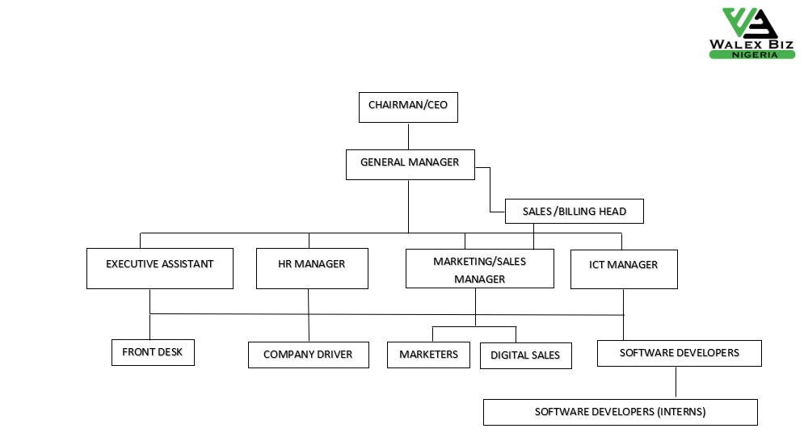
ORGANOGRAM

Slide 7
THANK YOU

